Slide 1
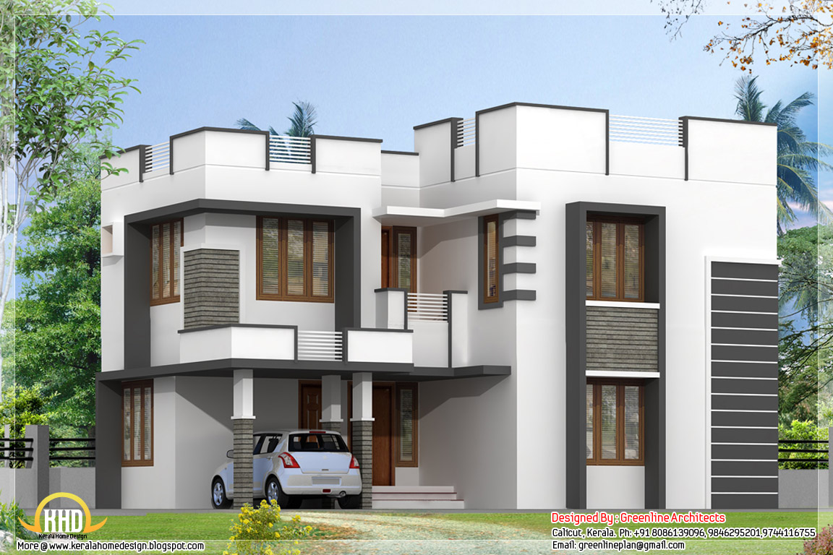

Bangalore Home Prices Project
Explore the factors influencing home prices in the vibrant city of Bangalore, India. Gain insights into the real estate market and uncover trends that can inform investment decisions.

Slide 2
Introduction to the Dataset
Comprehensive Real Estate Data
Diverse Residential Areas
The dataset contains detailed information on over 13,000 home sales in Bangalore, India from 2013 to 2018. It includes key attributes like location, size, number of bedrooms, bathrooms, and the final sale price.
The homes span a wide range of Bangalore's vibrant neighborhoods, from the bustling city center to the serene suburbs, providing a comprehensive view of the local real estate market.

Slide 3
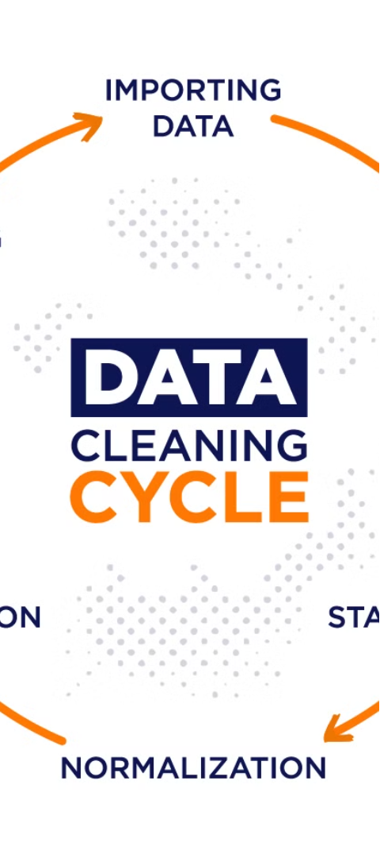
Data Cleaning and Preprocessing
1
Data Inspection
Thoroughly examine the dataset to identify any missing values, outliers, or inconsistencies that need to be addressed.
2
Handling Missing Data
Employ techniques such as imputation or removal to deal with any missing data points, ensuring the dataset is complete and ready for analysis.
3
Feature Engineering
Create new features by transforming or combining existing variables, enhancing the predictive power of the model.

Slide 4



Exploratory Data Analysis
Data Visualization
Statistical Analysis
Feature Engineering
Utilize a variety of visualizations to uncover insights and patterns in the home price data, such as scatter plots, histograms, and heatmaps.
Perform statistical tests to understand the relationships between features and identify any significant drivers of home prices in Bangalore.
Analyze the feature importance to determine which variables have the greatest impact on home prices, informing the feature engineering process.

Slide 5
Feature Engineering
1
Handling Missing Values
2
Encoding Categorical Features
Identify and address any missing values in the dataset using appropriate imputation techniques, such as mean, median, or mode imputation.
Convert any categorical variables into a numerical format that can be used by machine learning models, using techniques like one-hot encoding or label encoding.
3
Engineering New Features
4
Scaling and Normalization
Analyze the dataset and create new features that may be predictive of the target variable, such as combining existing features or deriving new ones from the data.
Ensure that the features have a similar scale by applying appropriate scaling or normalization techniques, such as min-max scaling or standardization.

Slide 6
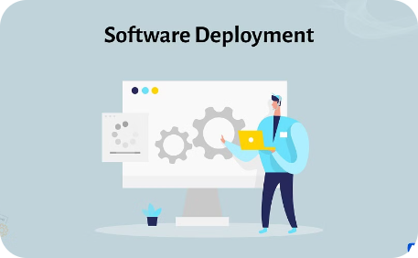
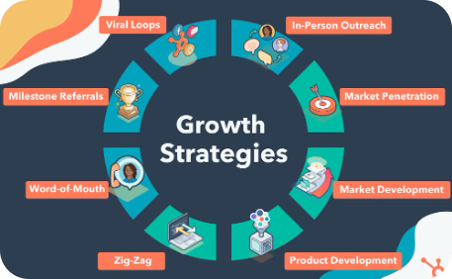
Deployment and Future Consideration
Seamless Deployment
Future Enhancements
The model is carefully deployed to a Flask Server, with combination of Html CSS & Js ensuring a smooth and reliable integration with existing systems.
The team continuously explores ways to improve the model, incorporating user feedback and industry best practices to drive future enhancements.

Slide 7
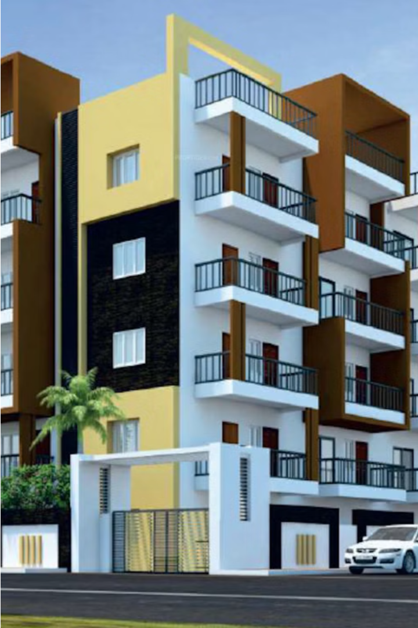
Snaps of Live Project
The Bangalore Home Prices project has been successfully deployed as a live web application. Screenshots showcase the intuitive user interface, data visualizations, and interactive features that allow users to explore home pricing trends in the city.
The live demo showcases the project's capabilities, including the ability to input property details and receive accurate price predictions based on the trained machine learning model.

Slide 8
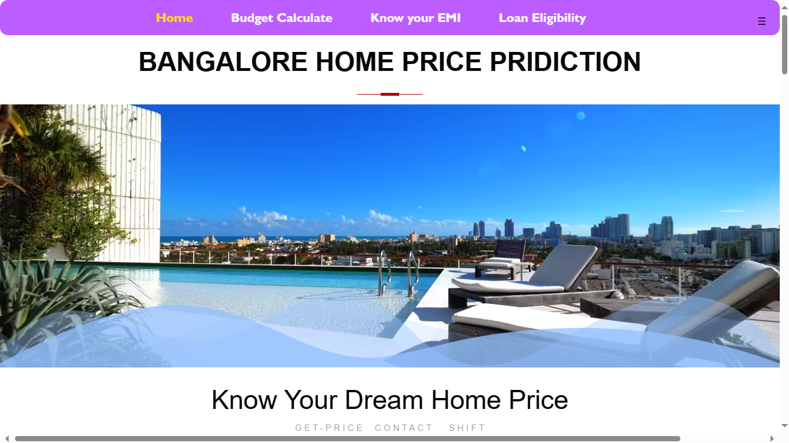
Home Page

Slide 9
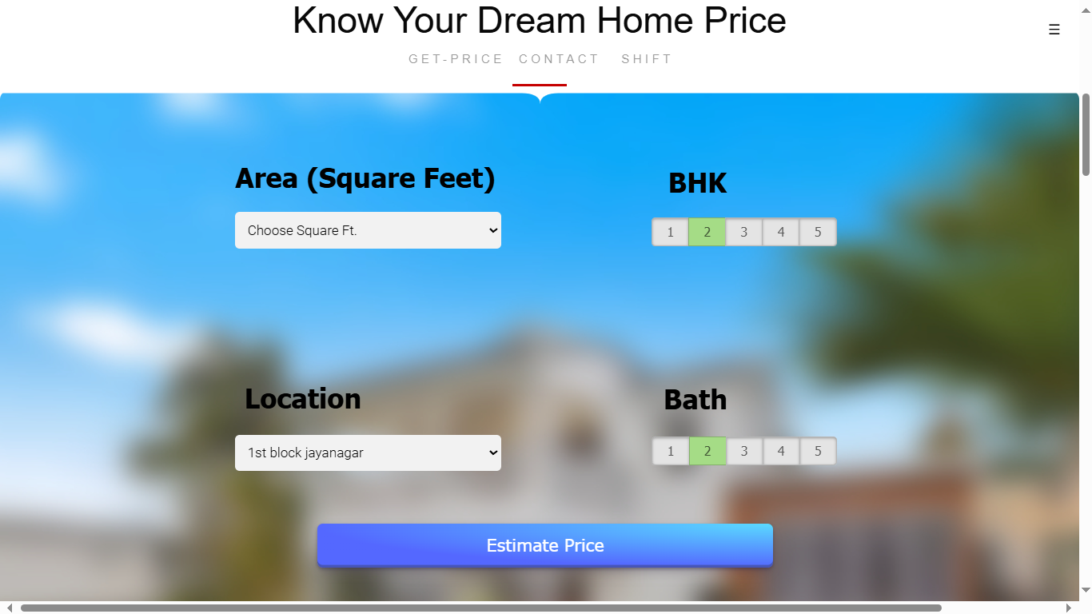
Estimate Home Price Module

Slide 10
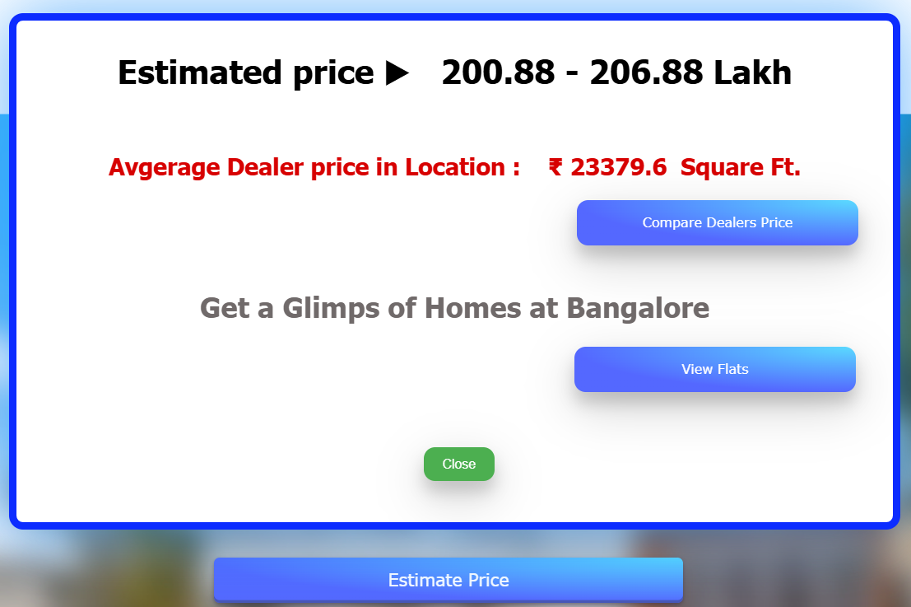
When Clicked On Estimate Price Button

Slide 11
Dealers Price Comparison
Compare Prices
Negotiate Confidently
Save Time and Money
Easily compare prices from multiple car dealerships in your area. Get the best deal by seeing the range of prices for the vehicle you're interested in.
Use the price comparison data to negotiate with dealers from a position of knowledge. Leverage the information to get the most competitive pricing.
Avoid overpaying by quickly identifying the dealerships offering the fairest prices. This module helps you make an informed decision and secure the best value.

Slide 12

Snaps of Dealers Comparison Module :

Slide 13
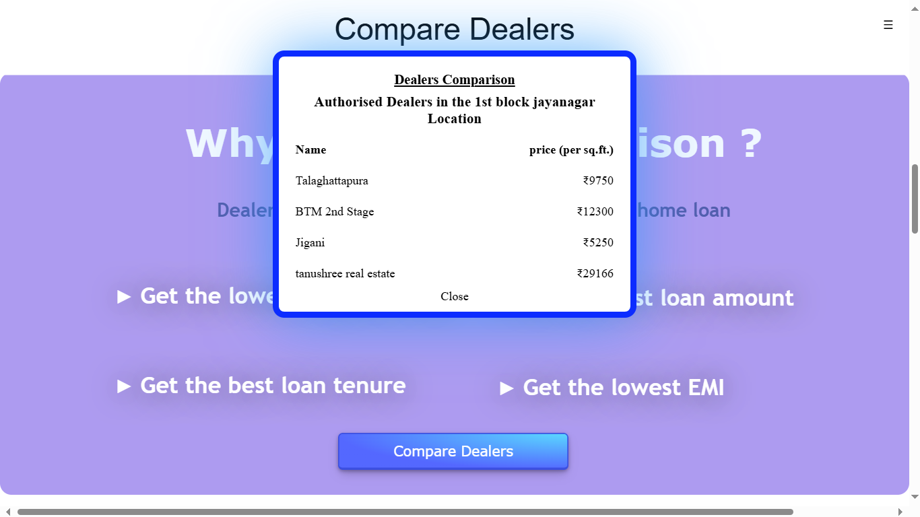
When Clicked On Button

Slide 14
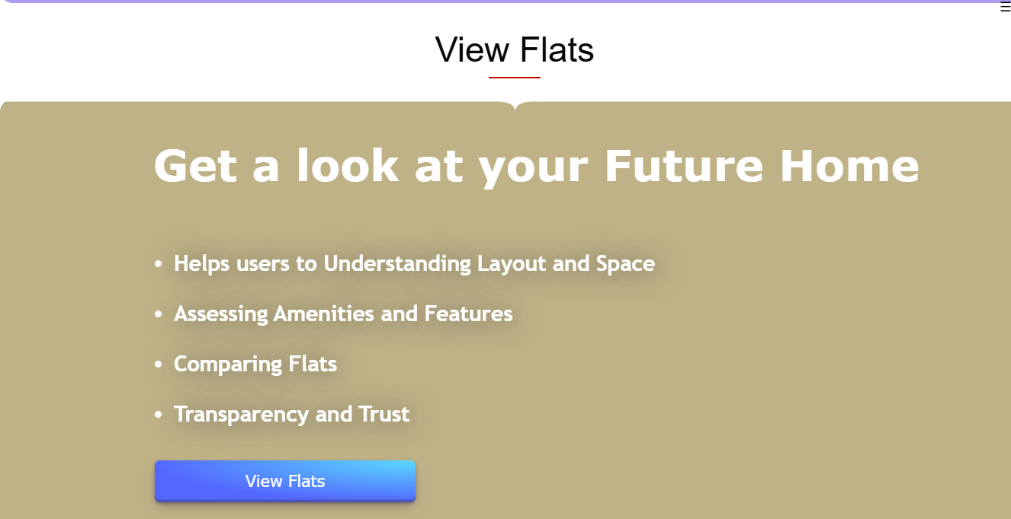
View Flats by Location in Bangalore
Easily search for and compare flats across different neighborhoods in Bangalore
Filter by criteria like number of bedrooms, budget, amenities, and more to find the perfect home
View detailed listings with property information, photos, and virtual tours
Get location-based recommendations for top areas to live in Bangalore based on your preferences

Slide 15
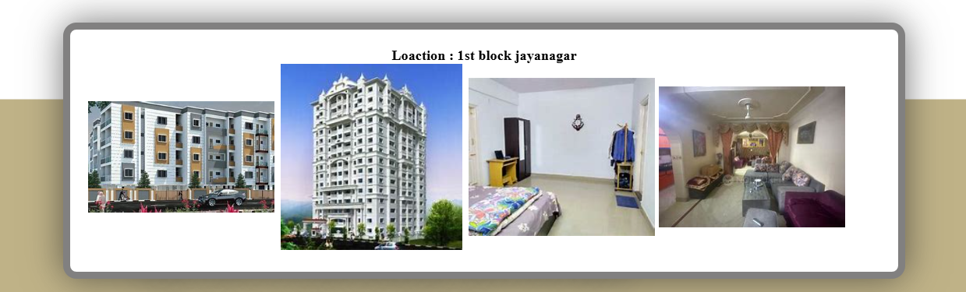
Preview the Homes In Selected location

Slide 16
Necessary Details for Buyers
Get the Personalized details by providing some Parameters.
Easily input necessary parameters and get useful insights that help in booking a home.
For that we provide 3 Tools.
Budget Calculator
Loan Eligibility
Emi Generator

Slide 17
1. Budget Calculator
Track Expenses
Log Incomes
Visualize Balances
Easily input your monthly expenses across categories like rent, utilities, groceries, and more. Get a clear overview of where your money is going.
Record your sources of income, whether it's a salary, freelance work, or other earnings. Understand your total monthly inflow.
See your income and expenses side-by-side to calculate your monthly balance. Identify areas to cut back or increase savings.

Slide 18
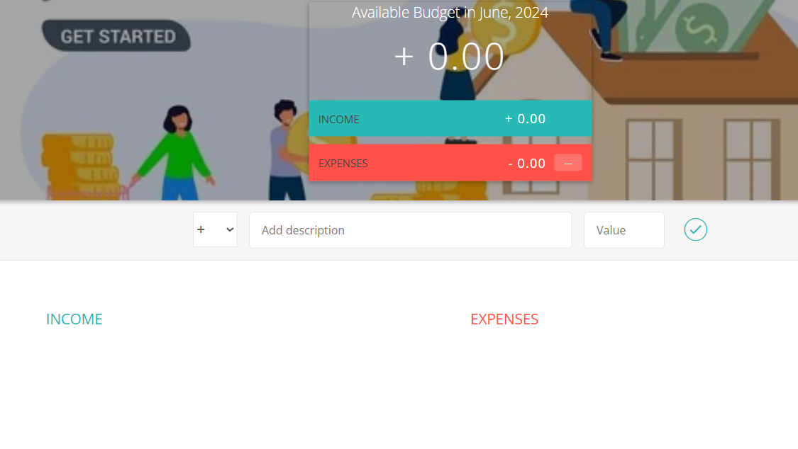
Snaps :

Slide 19
2. Loan Eligibility Module
Quickly determine your loan eligibility based on your financial profile and credit history
Simple online application: Fill out a few key details to get a personalized assessment
Real-time feedback: Receive instant insights on the loan amount and terms you may
qualify for
Get guidance on steps to improve your loan eligibility if needed

Slide 20
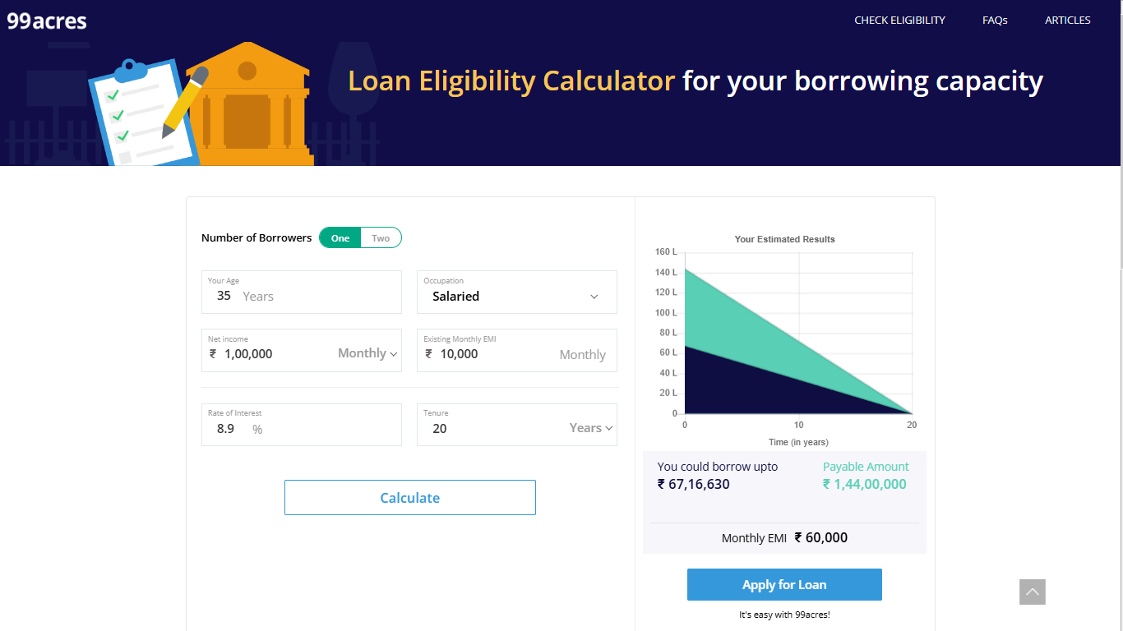
Snaps of loan Eligibilty Module

Slide 21
3. EMI Calculator for Loan
Personalized Estimates
Informed Decision-Making
Flexibility and Transparency
Accessible and User-Friendly
Our EMI calculator allows you to input your loan amount, interest rate, and repayment tenure to get a customized monthly payment estimate tailored to your financial situation.
By understanding your potential EMI, you can better plan your budget and make an informed decision about the loan that fits your needs and capabilities.
Experiment with different loan parameters to see how they impact your monthly payments. Our calculator provides transparent results to help you find the optimal loan solution.
The intuitive interface of our EMI calculator makes it easy for you to input your details and quickly get the information you need to make a well-informed loan decision.

Slide 22
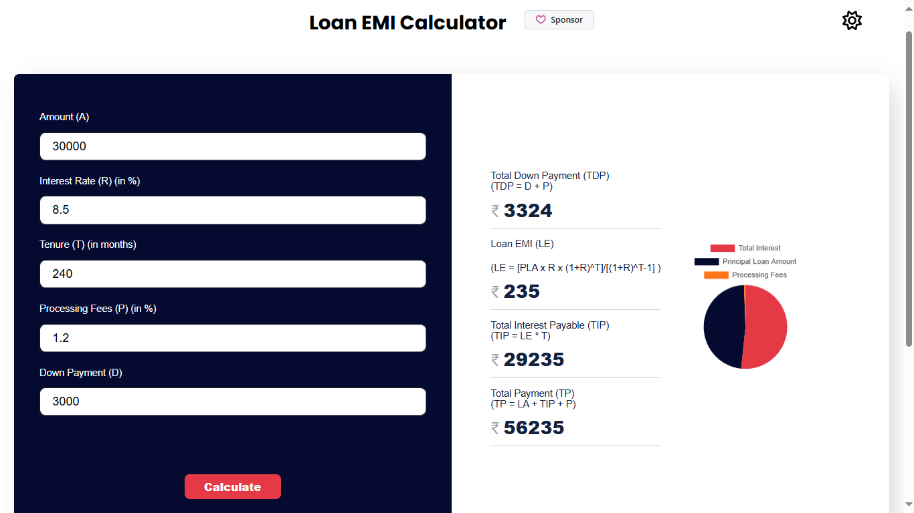
Snaps :

Slide 23



No Money ! No worry ! 😉
Loan Facilities
Personal Loans
Mortgage Loans
Business Loans
Secure personal loans at competitive rates to finance your goals, whether it's a home renovation, debt consolidation, or a special occasion.
Get the support you need to make your homeownership dreams a reality. Our mortgage experts can guide you through the process and find the best loan options.
Fuel the growth of your small business with our tailored business loan solutions. Unlock the capital you need to expand, invest in equipment, or manage cash flow.

Slide 24
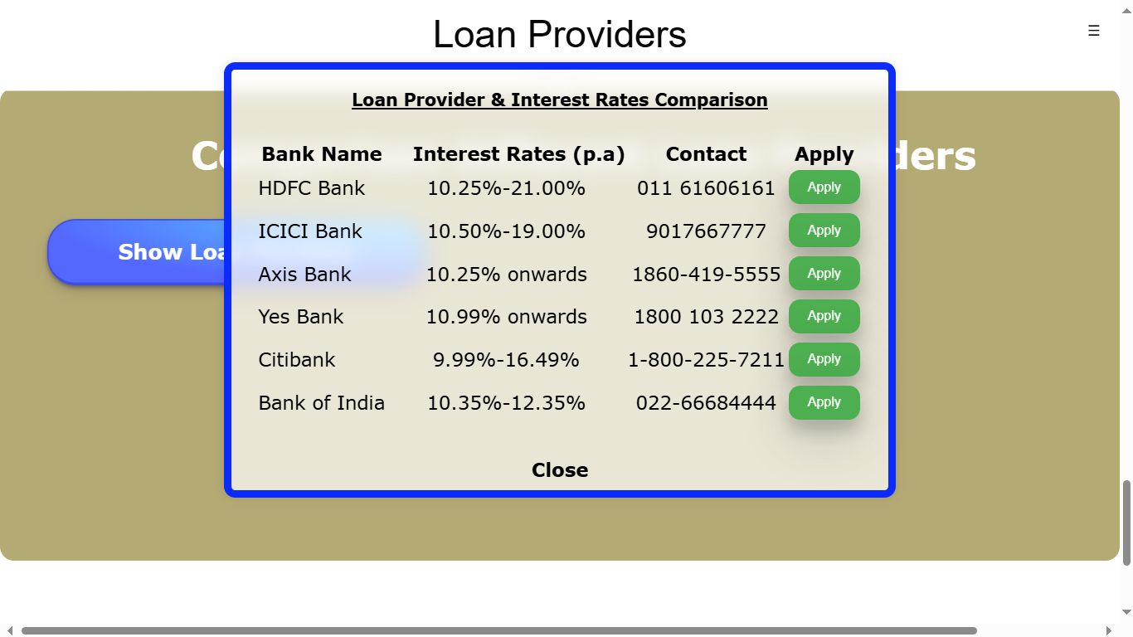
Snaps of loan Module in Project

Slide 25
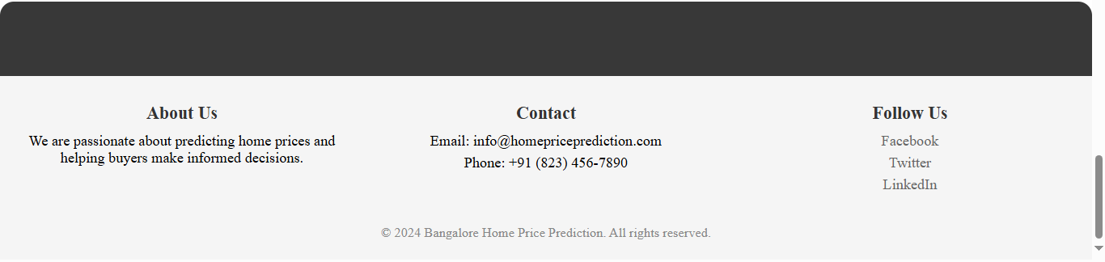
Contact Us
Get in touch with our team of experts to learn more about our Bangalore home prices project. Whether you have questions, feedback, or are interested in collaborating, we're here to assist you.
Our office is located in the heart of the city, with easy access to public transportation and ample parking. Visit us in person or connect with us through our convenient online channels.

Slide 26

Thank You

